Slide 1


Basic Microscope Optics
Tom Zimmerman
IBM Research-Almaden
Center for Cellular Construction
5.20.23
This material is based upon work supported by the NSF under Grant No. DBI-1548297.
Disclaimer: Any opinions, findings and conclusions or recommendations expressed in this material are those of the authors and do not necessarily reflect the views of the National Science Foundation.

Slide 2
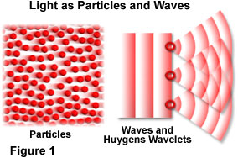
https://www.olympus-lifescience.com/en/microscope-resource/primer/lightandcolor/particleorwave/

Slide 3
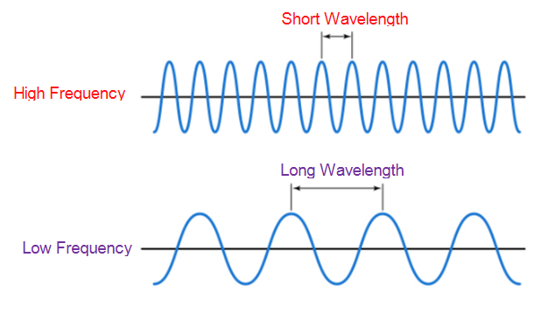
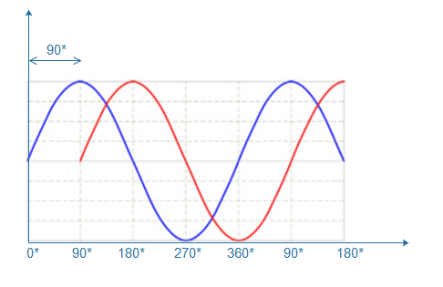
phase
https://www.techplayon.com/wavelength-frequency-amplitude-phase-defining-waves/

Slide 4
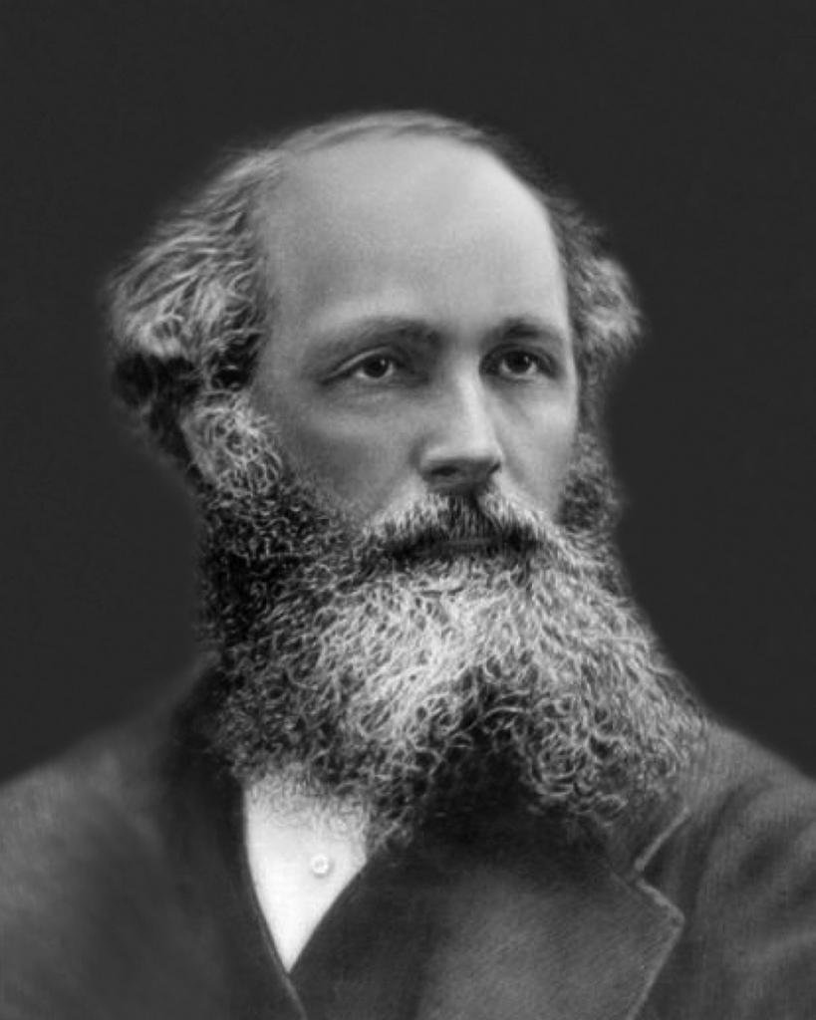
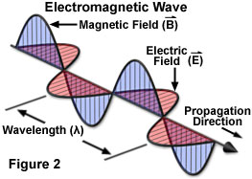
James Clerk Maxwell
(1831-1879)
"A Dynamical Theory of the Electromagnetic Field"
https://micro.magnet.fsu.edu/primer/lightandcolor/electromagintro.html

Slide 5
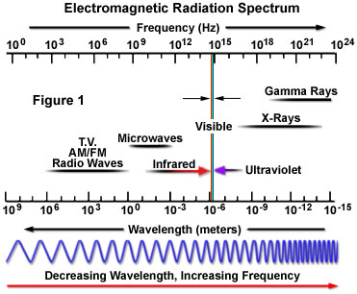
https://micro.magnet.fsu.edu/primer/lightandcolor/electromagintro.html

Slide 6
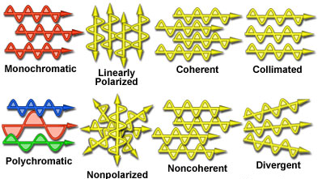
Waveform States
E vectors vibrate in parallel planes
Same phase
Coaxial
Same wavelength
https://micro.magnet.fsu.edu/primer/lightandcolor/electromagintro.html

Slide 7
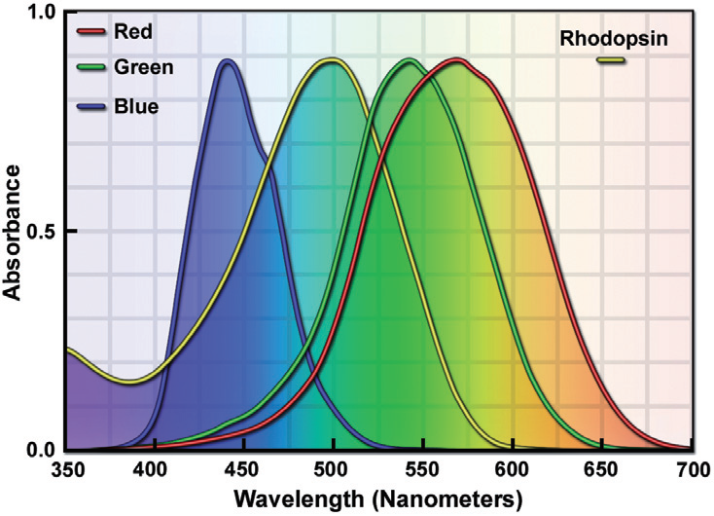
Rhodopsin in rod cells 40 time more sensitive than cone cells
Rods
Night
95%
Cones
Day
5%

Slide 8
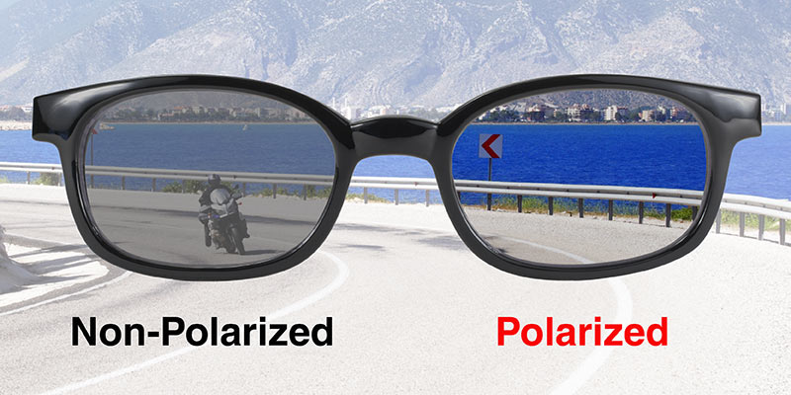
Polarization
https://www.pacificcoastsunglasses.com/store/blog/blog/8/To-Polarize-or-Not-to-Polarize-A-Motorcyclist-s-Eyewear-Decision

Slide 9
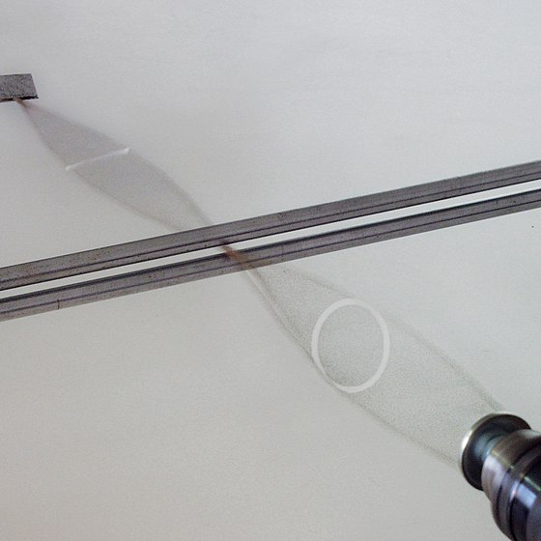
Circular polarization on rubber thread, converted to linear polarization
Source: Wikipedia “Polarization”

Slide 10
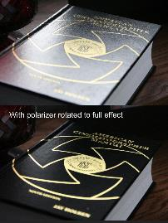
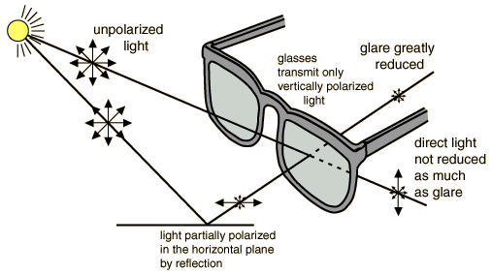
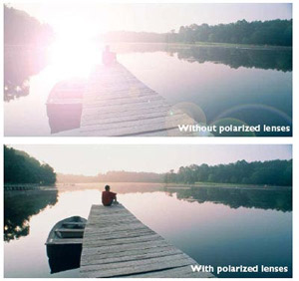
Glare
Sunlight (and most light) is unpolarized. Light becomes polarized horizontally when it reflected off a surface parallel to the ground, creating glare. Sunglasses that only permit vertically polarized light block glare.
https://ascmag.com/blog/shot-craft/understanding-polarizing-filters
https://www.sunglasspicks.com/to-polarize-or-not/
https://sites.google.com/site/sunglassscience/the-anatomy-of-sunglasses/polarization

Slide 11
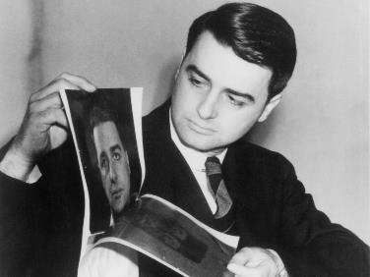
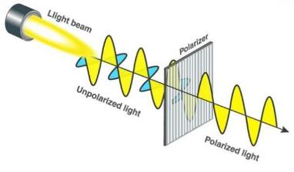
How Polarizer Filters Are Made
Edwin H. Land (1909-1991)
Scientist, Inventor, co-founder Polaroid Corp.
Original (1932, Land)
Many microscopic crystals of iodoquinine sulphate (herapathite) embedded in a transparent nitrocellulose polymer film [first observed by Danish chemist S.M. Jorgensen 1877]. The needle-like crystals are aligned during the manufacture of the film by stretching or by applying electric or magnetic fields. With the crystals aligned, the sheet is dichroic: it tends to absorb light which is polarized parallel to the direction of crystal alignment but to transmit light which is polarized perpendicular to it.
Now (K-sheet)
Polyvinyl alcohol (PVA) plastic is stretched during manufacturing, forcing the molecules in the plastic to line up in long parallel chains with tiny gaps between them — think of the bars of a jail cell, or a picket fence. These chains are invisible to the naked eye. This stretched polymer is then dipped in a solution of iodine, and the iodine molecules attach themselves to the polymer chains. The resulting structure allows the pola foil to absorb light waves that are parallel to the long chains while allowing waves that are perpendicular to pass through unaltered.
https://brainly.in/question/15573897
https://ascmag.com/blog/shot-craft/understanding-polarizing-filters
https://museemagazine.com/features/2019/10/10/impact-edwin-land-immediate-gratification

Slide 12
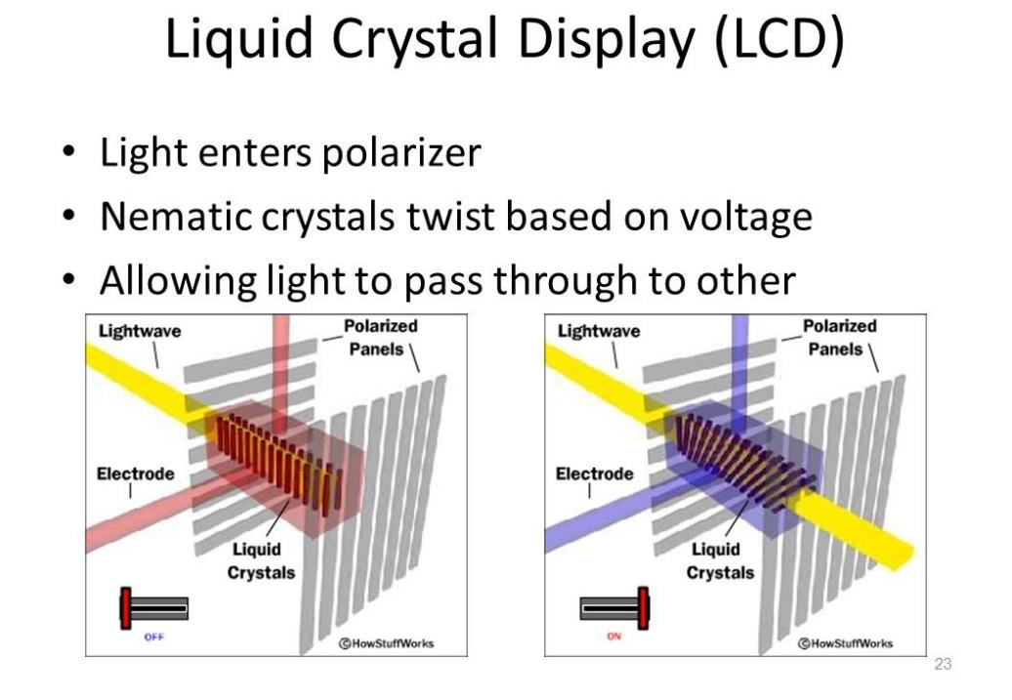
Example liquid crystal used in LCD: mixture of 2-(4-alkoxyphenyl)-5-alkylpyrimidine with cyanobiphenyl

Slide 13
Duality of Light
Particle or Wave?

Slide 14
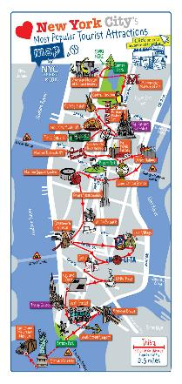
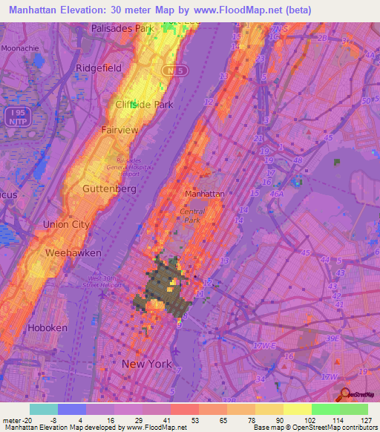
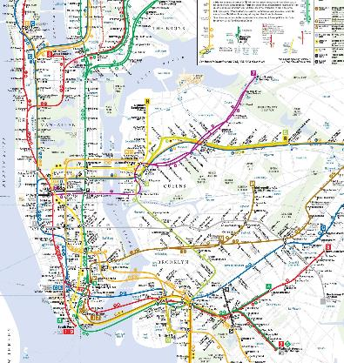
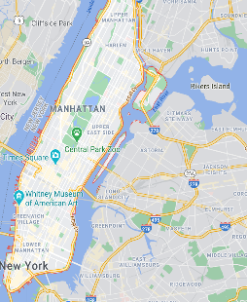
Which is the real Manhattan?
Which is the best MAP for Manhattan?
Tourist Sites Subway System Topological Highways
https://www.maps-of-the-usa.com/usa/new-york/new-york/detailed-map-of-most-popular-tourist-attractions-of-manhattan-nyc
https://www.google.com/maps/place/Manhattan
https://www.nytimes.com/2020/02/25/nyregion/michael-hertz-dead.html
https://www.floodmap.net/Elevation/ElevationMap/?gi=5125771

Slide 15
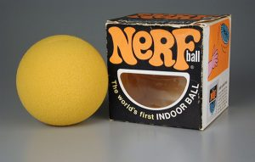
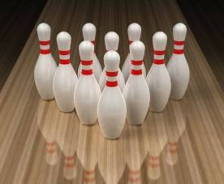
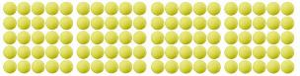
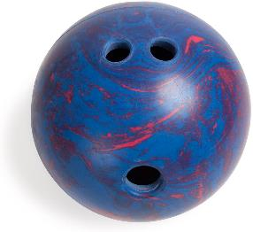
Red Light
Blue Light
Platinum Wire

Slide 16
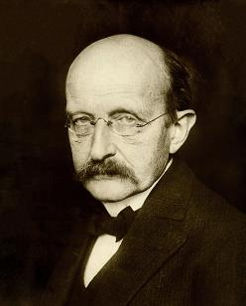
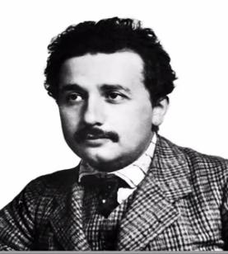
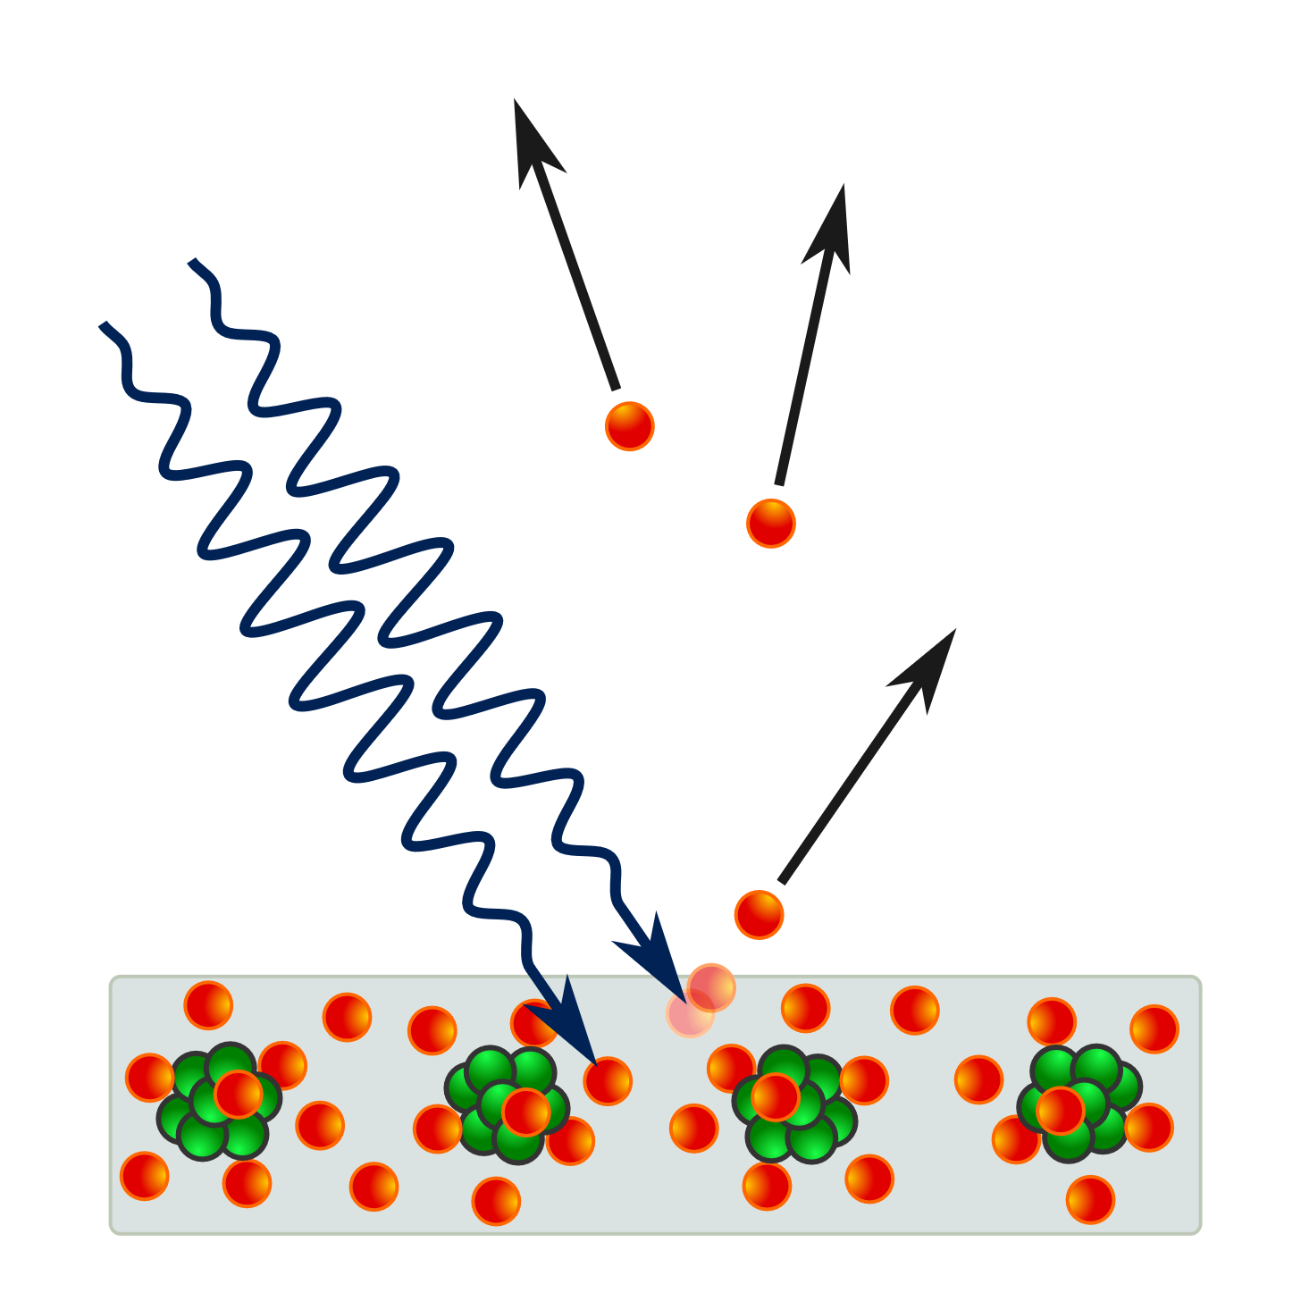
Photoelectric Effect
Max Planck
Einstein
E=hf
h=Planck’s Constant
electrons
Nobel Prize in Physics 1921
photons
(massless particle!)
metal

Slide 17
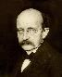
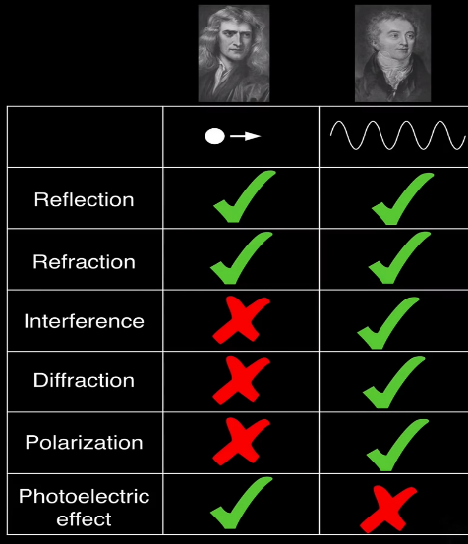

Which Model To Use Depends on Scale
Is Light a ..... Particle or Wave?
h=Planck’s constant
PARTICLE if Energy ~ hf
WAVE if Size ~ Wavelength
Newton
Young
Einstein
Photoelectric Effect
Do they bounce off objects?
Do they bend when moving form one medium to another?
Can they interfere with one another?
Do they bend around objects or go through an opening?
Can they be polarized through small slits or gradings?
Can they knock electrons out of a material?
https://youtu.be/h1tflE-L2Dc

Slide 18
Electromagnetic Waves

Slide 19
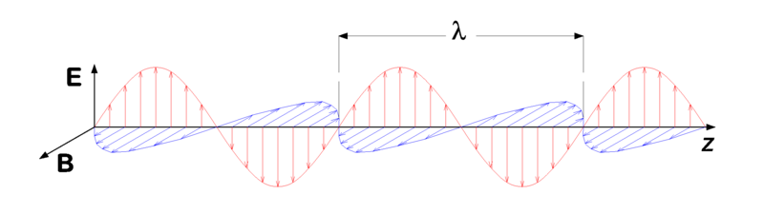
Transverse Electromagnetic Waves
A "vertically polarized" electromagnetic wave of wavelength λ has its electric field vector E (red) oscillating in the vertical direction. The magnetic field B (or H) is always at right angles to it (blue), and both are perpendicular to the direction of propagation (z).

Slide 20
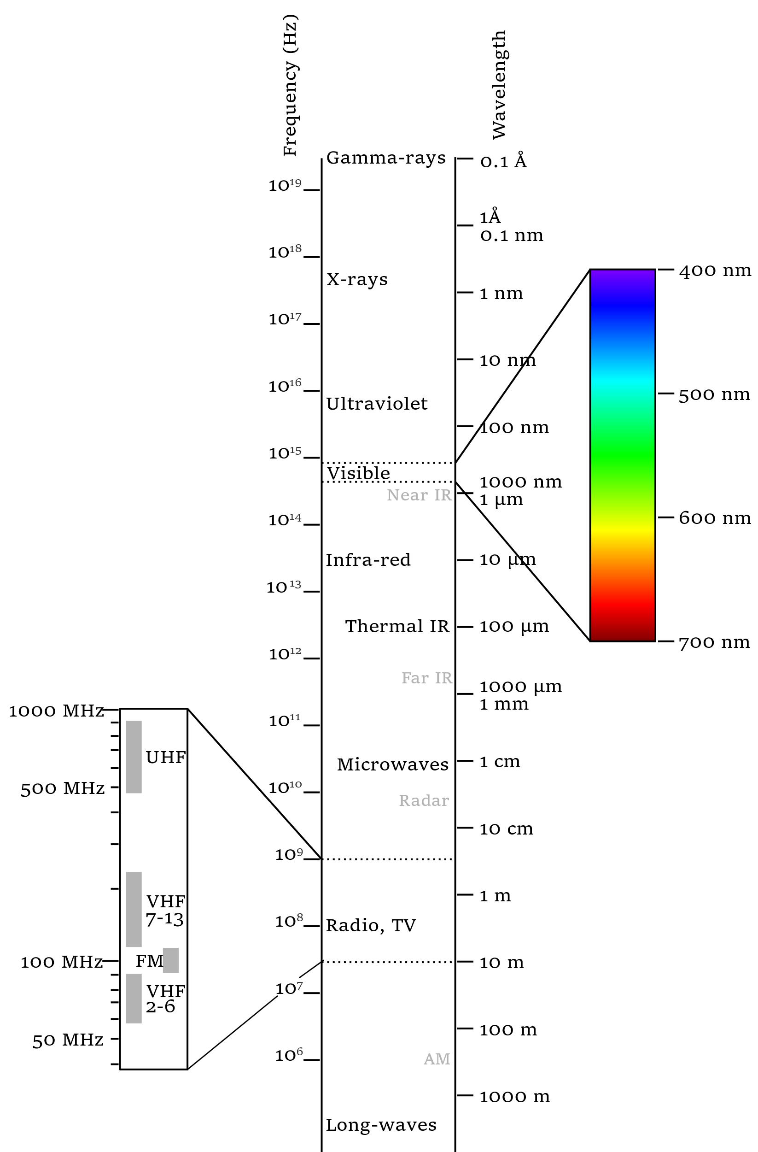
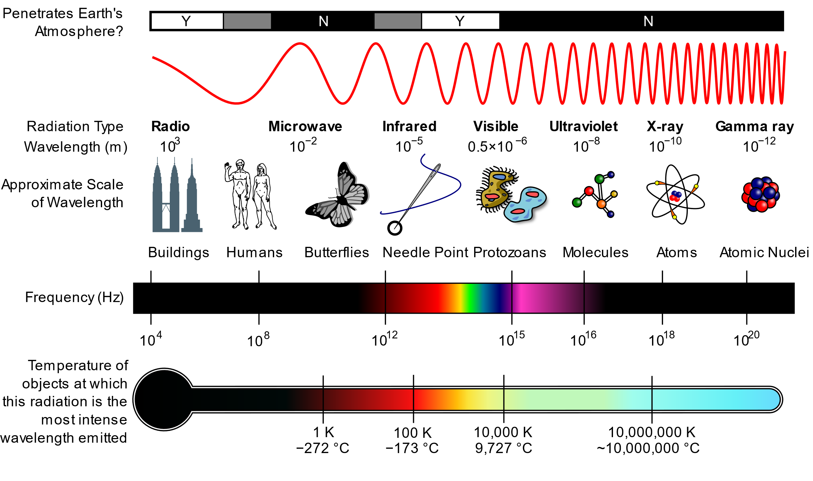
Electromagnetic Spectrum
https://en.wikipedia.org/wiki/Electromagnetic_spectrum

Slide 21
Optical Lenses

Slide 22
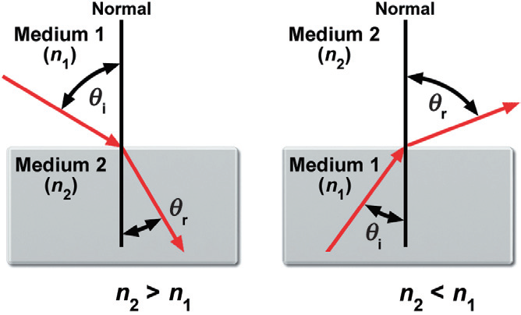
Refraction & Snell’s Law

Slide 23
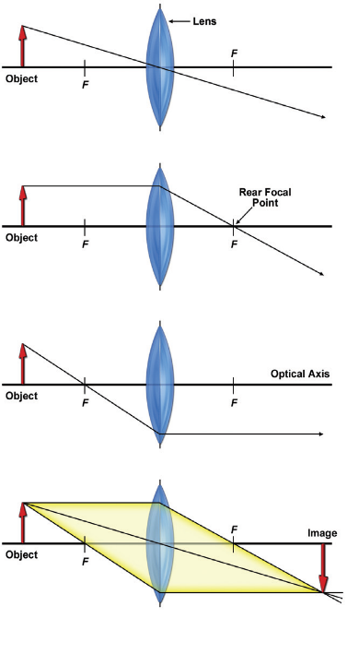
Ray Tracing for Thin Lens
(a) Ray passing through lens center remains un-deviated
(b) Ray parallel to optical axis passes through rear focal point.
(c) Ray passing through front focal point refracted parallel to optical axis.
(d) Intersection of two of three rays defines the image plane.

Slide 24
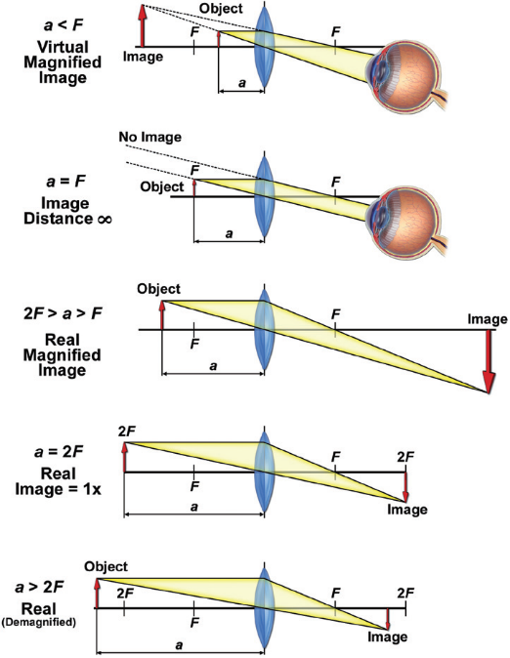
Microscope
Telescope
Microscope
Copy Lens

Slide 25
Digital Holographic Reconstruction

Slide 26
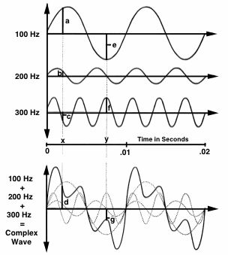
Fourier Analysis & Synthesis
Any time-varying (complex) sound can be analyzed to find its frequency components.
Any complex wave can be constructed by adding together sine waves of appropriate frequency, amplitude, and phase.
https://hearinghealthmatters.org

Slide 27
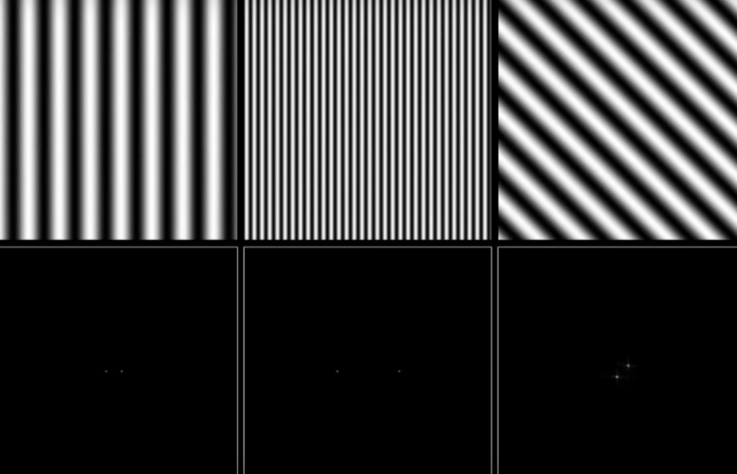
https://youtu.be/gwaYwRwY6PU

Slide 28
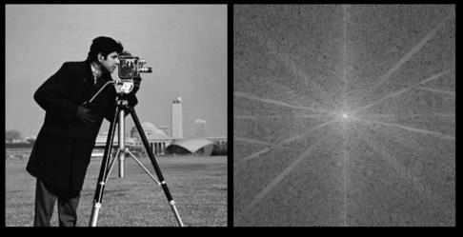

Image of “cameraman” Copyright MIT

Slide 29
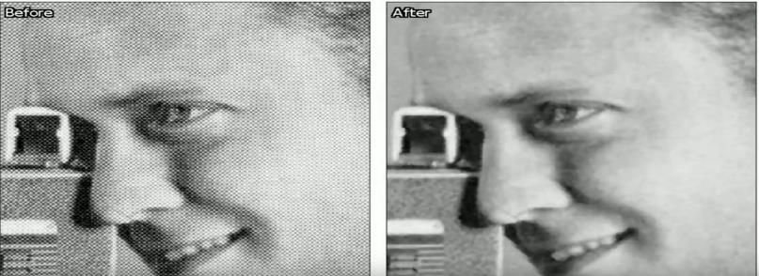
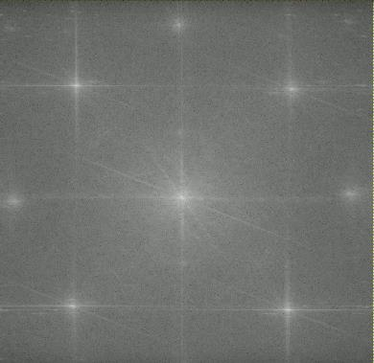
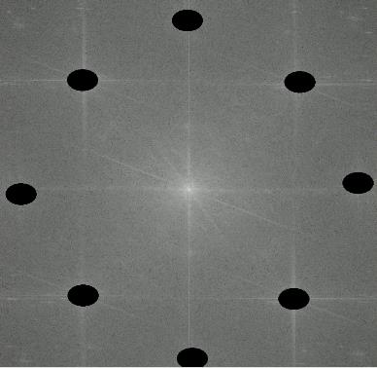
https://youtu.be/3137dDa6P4s

Slide 30
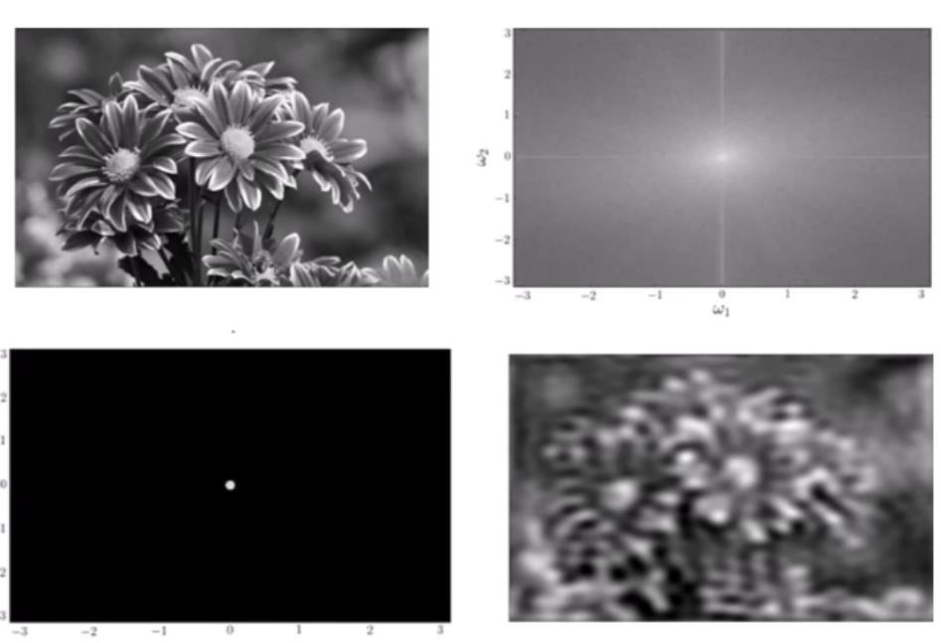
Low Pass Filter
https://youtu.be/oACegp4iGi0

Slide 31
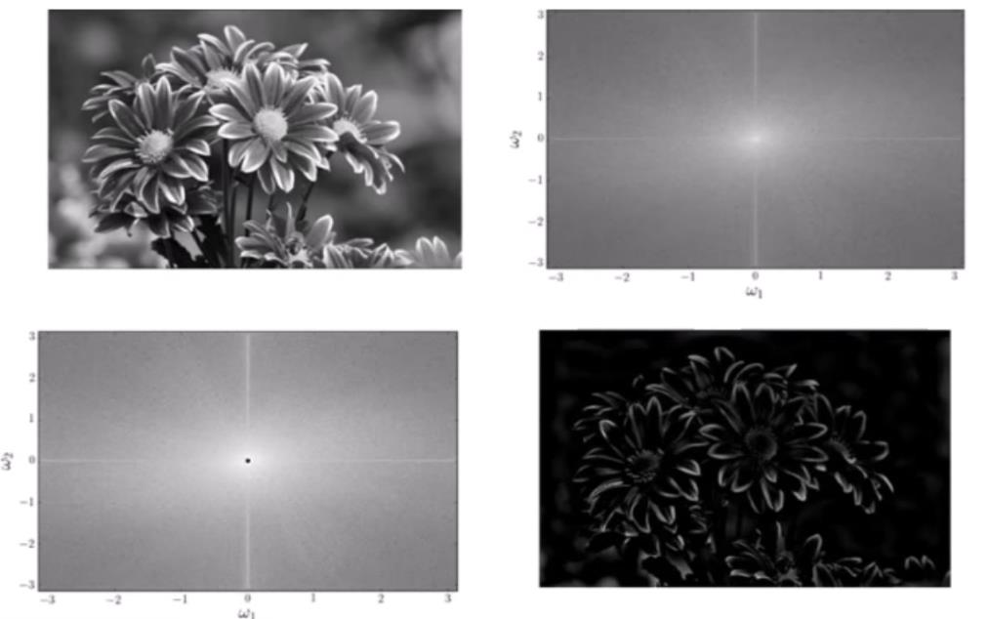
High Pass Filter
https://youtu.be/oACegp4iGi0

Slide 32
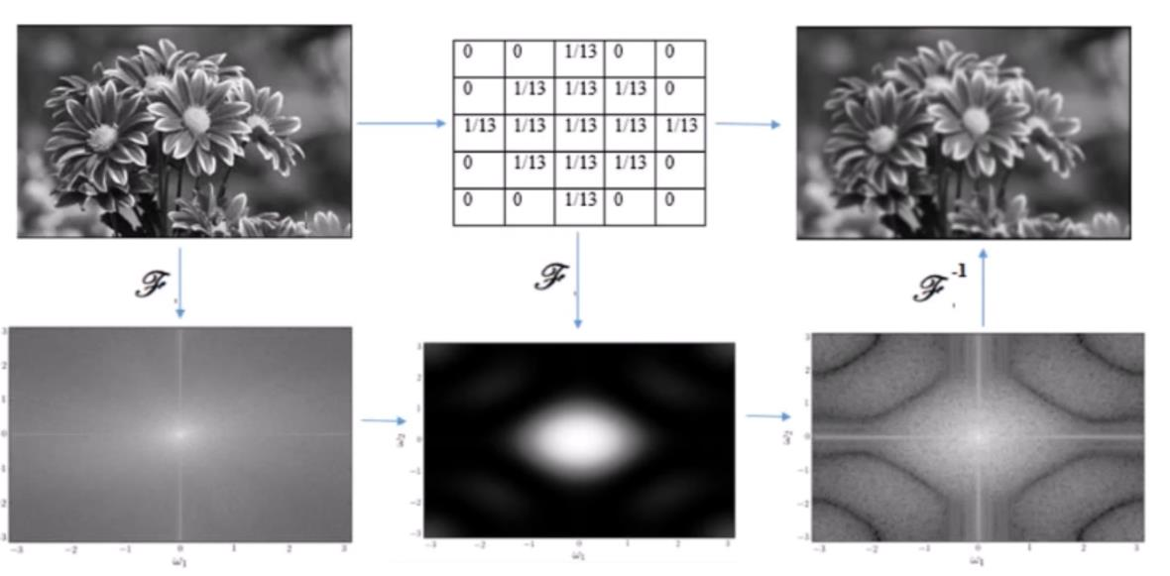
Low Pass Filtering in the Spatial and Frequency Domain
Convolution Kernel
Multiplication in the Frequency Domain = Convolution in the Time Domain

Slide 33
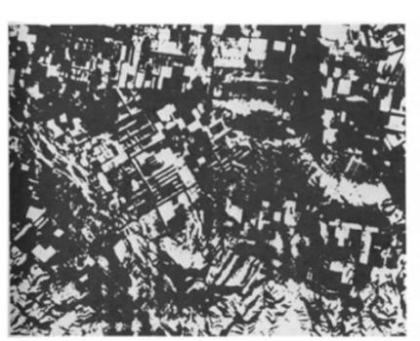
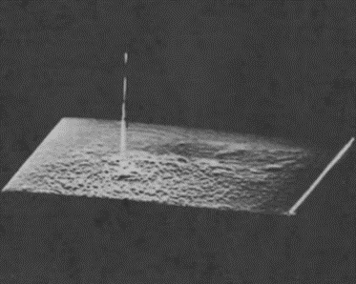
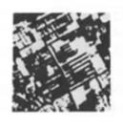
Cross-Correlation
Test Image f(x,y) Template Image h(x,y) Cross Correlation
C(i,j) = f(x,y)h(i+x,j+y)dxdy
C=F⁻¹[F{f} F{h}]
Multiplication in the Frequency Domain = Convolution in the Time Domain
Hetch, Optics
https://youtu.be/MQm6ZP1F6ms

Slide 34
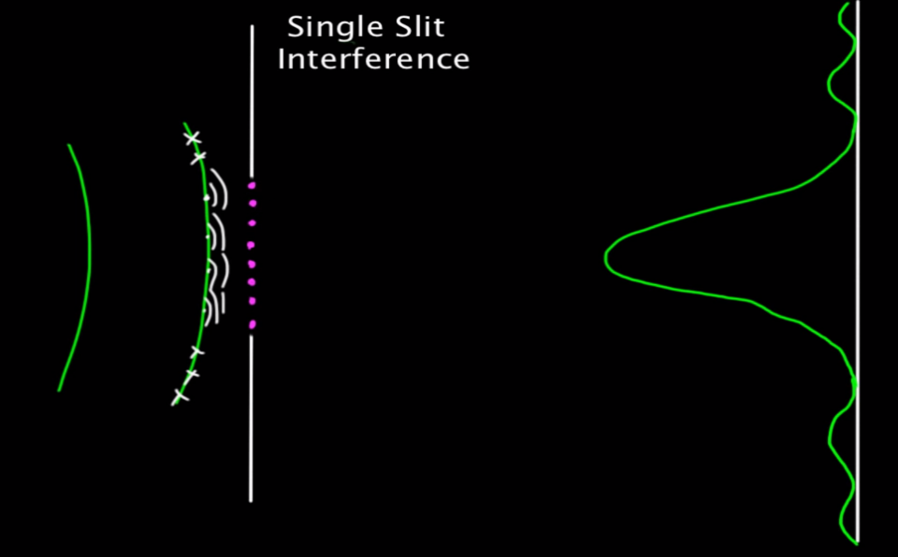
Huygens Principle (1678)
3W/D
2W/D
W/D
W
D

Slide 35
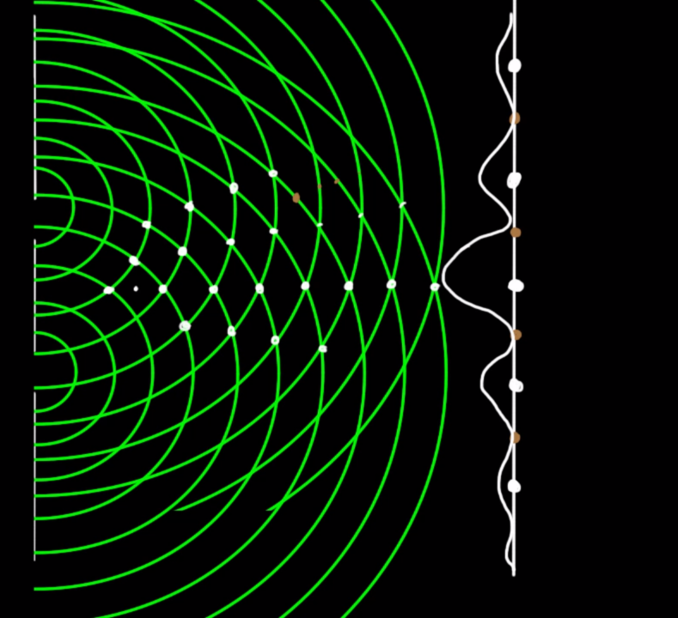
Young’s Experiment (1801) Double Slit Experiment

Slide 36
Young’s Experiment (1801) Double Slit Experiment

Slide 37
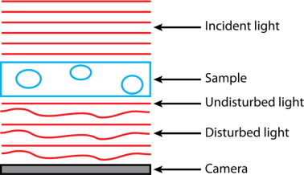
https://www.sciencedirect.com/science/article/pii/S1046202317302384

Slide 38


Creating Hologram of Point Object
Image Sensor
Reference Beam
Interference Pattern
LASER
Subject Beam
Subject
(point)
Z
Fresnel Zone Plate
https://github.com/manoharan-lab/holopy
Manoharan Lab, Harvard
https://holopy.readthedocs.io/en/latest/users/index.html
https://manoharan.seas.harvard.edu/holographic-microscopy

Slide 39

Reconstruction with Laser
Laser
Reconstructed
Subject
Photographic Film of Interference Pattern
(Fresnel Zone Plate for point source)

Slide 40

https://youtu.be/oq9UsYHyUvo

Slide 41

https://youtu.be/oq9UsYHyUvo

Slide 42

https://youtu.be/oq9UsYHyUvo

Slide 43

https://youtu.be/oq9UsYHyUvo

Slide 44

(no complex part)
# make a grid the same size of the image
M, N = input_img.shape # get image size, rows M, columns N
kx,ky = x / (dxy * N), y / (dxy * M)
kxy2 = (kx * kx) + (ky * ky)
# compute phase aberration in the grid
_ph_abbr = np.exp(-1j * np.pi * wvlen * zdist * kxy2) # Pi * wavelength * Z distance
https://youtu.be/_BzEi3PD3Y0

Slide 45
When I try and install holopy opening a terminal and typing …. conda install -c conda-forge holopy
I get this error…
UnsatisfiableError: The following specifications were found
to be incompatible with the existing python installation in your environment:
- holopy -> python[version='3.5.*|3.6.*']
If python is on the left-most side of the chain, that's the version you've asked for.
When python appears to the right, that indicates that the thing on the left is somehow
not available for the python version you are constrained to. Your current python version
is (python=3.7). Note that conda will not change your python version to a different minor version
unless you explicitly specify that.
The following specifications were found to be incompatible with each other:
Package wincertstore conflicts for:
holopy -> matplotlib -> setuptools -> wincertstore[version='>=0.2']
python=3.7 -> pip -> setuptools -> wincertstore[version='>=0.2']
Package setuptools conflicts for:
python=3.7 -> pip -> setuptools
holopy -> matplotlib -> setuptools
Package wheel conflicts for:
python=3.7 -> pip -> wheel
holopy -> python=3.6 -> pip -> wheel
Package certifi conflicts for:
holopy -> matplotlib -> setuptools -> certifi[version='>=2016.09']
holopy -> python=3.6 -> pip -> requests -> certifi[version='>=2017.4.17']
python=3.7 -> pip -> setuptools -> certifi[version='>=2016.09']
So I installed python 3.6 by typing….. conda create --name holo python=3.6 pip
(https://mlpipes.com/changing-the-python-version-in-conda/)
Then activate the new environment type …. conda activate holo
And try again by typing ….
BTW to deactivate the environment type… conda deactivate
Finally I created a shortcut that would launch IDLE using Python 3.6 following these directions
Adding this in the target of the shortcut "C:\Users\ThomasZimmerman\Anaconda3\envs\holo\Lib\idlelib\idle.pyw"
https://stackoverflow.com/questions/34881105/how-to-run-idle-for-python-3-in-a-conda-environment/47986798#47986798

Slide 46


+2 -1 -2 +148 -4 +1
+2 -1 +35 +72 +35 +1
d>0
d>10
dmax>10

Slide 47





Canny Edge Detection Process
+2 -1 -2 +148 -4 +1
+2 -1 +35 +72 +35 +1
Definitely Edge
Edge only if connected to Definite Edge
Never an Edge
https://www.mathworks.com/help/images/apply-gaussian-smoothing-filters-to-images.html
An improved image processing technique for asphalt concrete X-ray CT images Jun 2013, Habtamu M. Zelelew, HM et al.

Slide 48

https://www.legupcomputing.com/blog/index.php/2017/08/25/canny-edge-detector-using-legup/

Slide 49


Canny Edge Detection
https://www.pyimagesearch.com/2019/03/04/holistically-nested-edge-detection-with-opencv-and-deep-learning/

Slide 50





Sobel Convolution Kernels
1/16*
https://www.legupcomputing.com/blog/index.php/2017/08/25/canny-edge-detector-using-legup/
http://i.stack.imgur.com/GvsBA.jpg
Sobel Convolution Kernels https://homepages.inf.ed.ac.uk/rbf/HIPR2/sobel.htm

Slide 51



The Laplace operator is a second order differential operator in the n-dimensional Euclidean space, defined as the divergence (∇·) of the gradient (∇f ). Thus if f is a twice-differentiable real-valued function, then the Laplacian of f is defined by
The divergence of different vector fields. The divergence of vectors from point (x,y) equals the sum of the partial derivative-with-respect-to-x of the x-component and the partial derivative-with-respect-to-y of the y-component at that point:
The gradient, represented by the blue arrows, denote the direction of greatest change of a scalar function. The values of the function are represented in greyscale and increase in value from white (low) to dark (high).

